Slide 1
comments are terrible:
but they don’t have to be
Greg Barber, The Coral Project/The Washington Post
Talia Stroud, Engaging News Project/The University of Texas at Austin
Erica Palan, Philly.com
#SXSW #comments

Slide 2
Engaging News Project
To provide research-based techniques for engaging online audiences in commercially viable and democratically beneficial ways.

Slide 3
Who comments?
Who reads the comments?
What do commenters want?
Find the report at engagingnewsproject.org

Slide 4
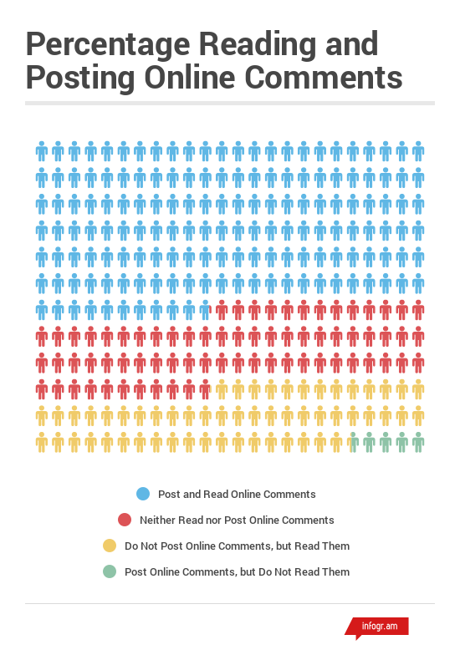

Slide 5
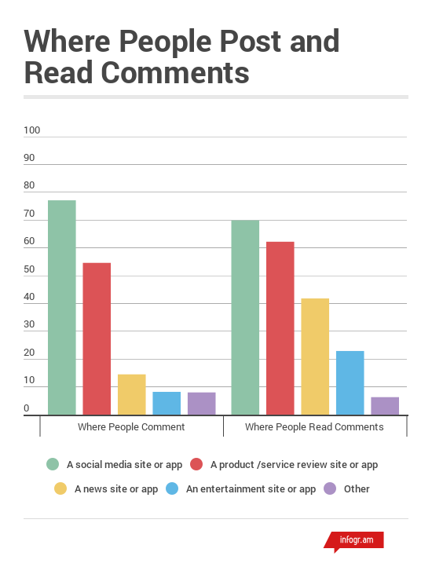

Slide 6
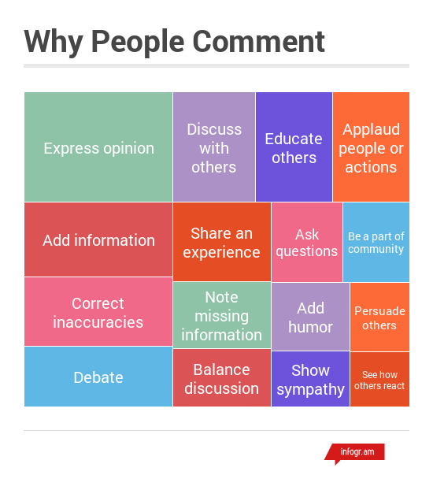

Slide 7
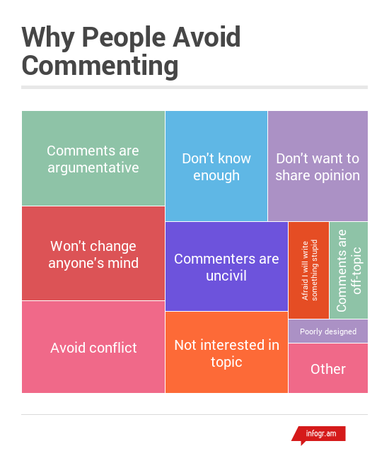

Slide 8
demographics

Slide 9
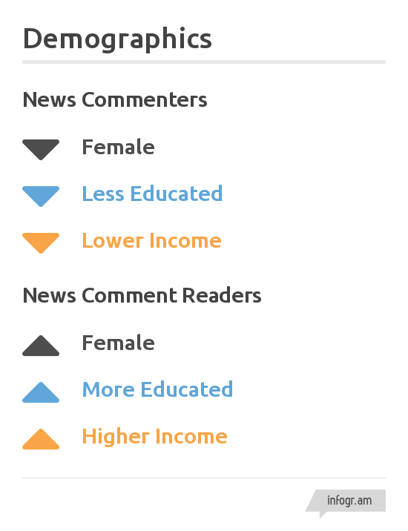
demographics

Slide 10
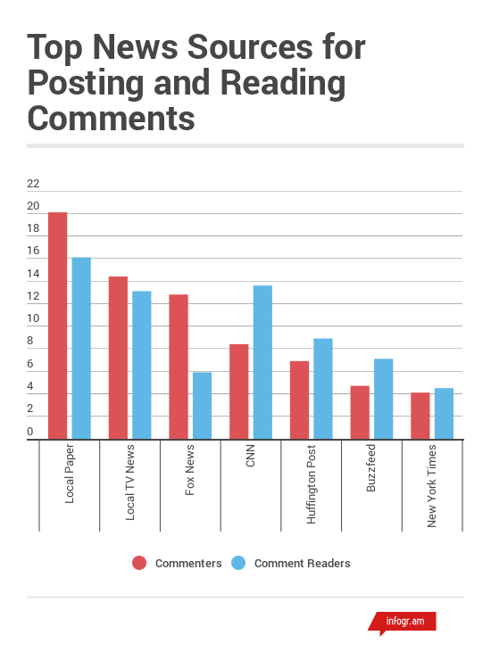

Slide 11
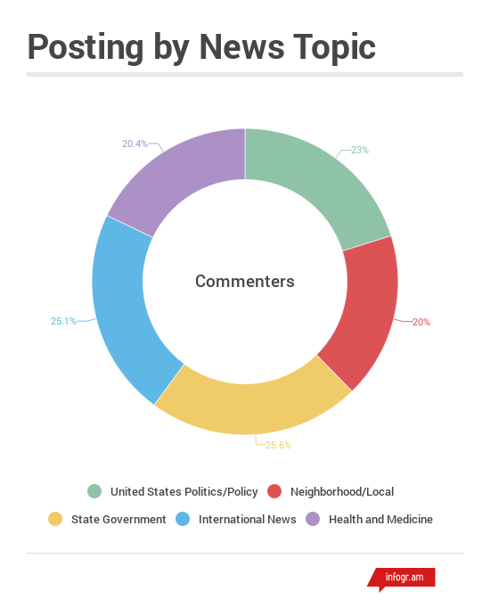

Slide 12
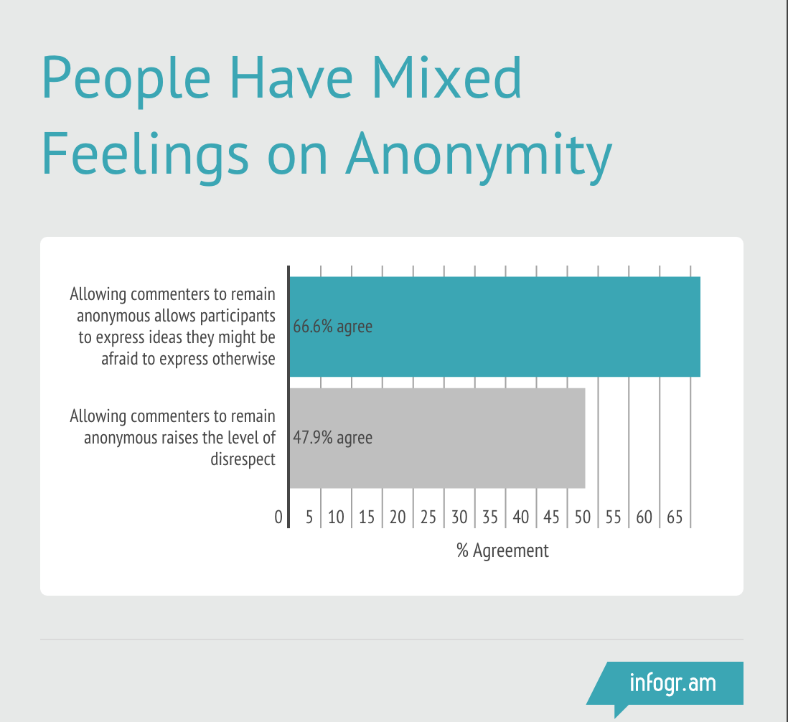

Slide 15
Questions & Comments?
@engagingnews
/engagingnewsproject
engagingnewsproject.org
Notes:
*

